Slide 1
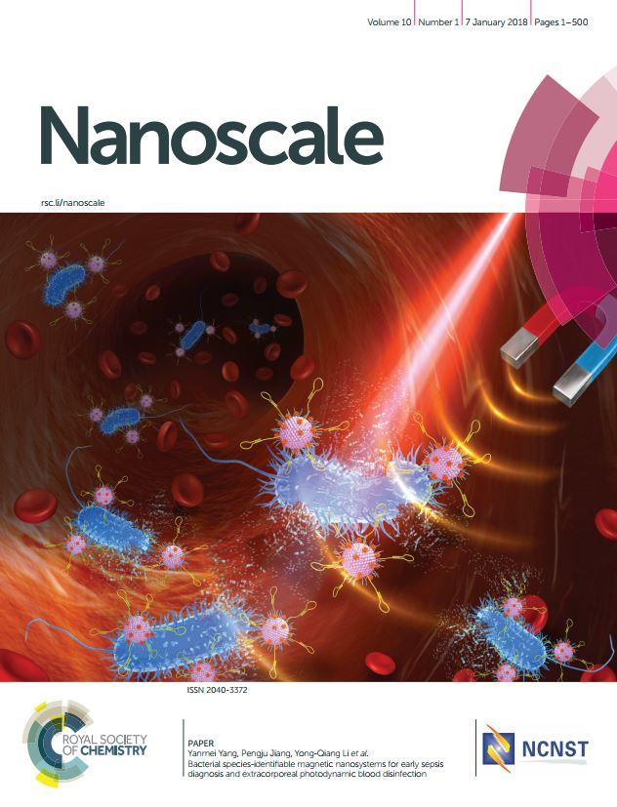
A high impact peer reviewed journal publishing experimental and theoretical work across the breadth of nanoscience and nanotechnology
High impact factor 7.367*.
Publishing high quality, community-spanning research by leading international groups.
Indexed in MEDLINE and ISI.
All submissions handled by our high-profile Editors, all researchers within the field.
Collaborative venture between the Royal Society of Chemistry and National Center for Nanoscience and Technology (NCNST).
Submit your research today at www.rsc.org/nanoscale
*2016 Journal Citation Reports ® (Clarivate Analytics, June 2017)

Slide 2
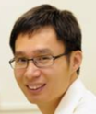
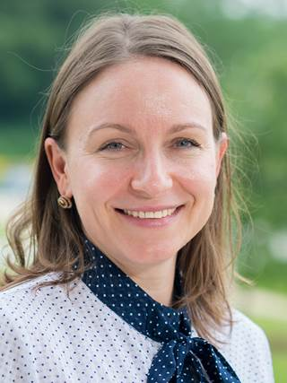
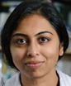
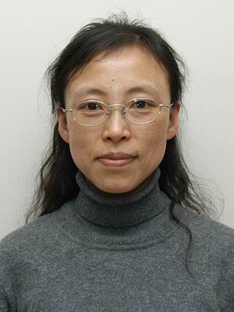
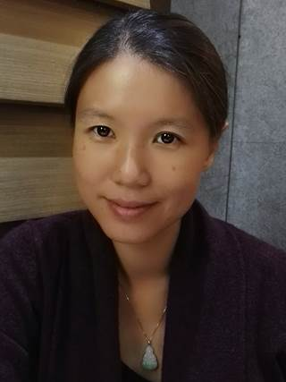
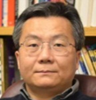
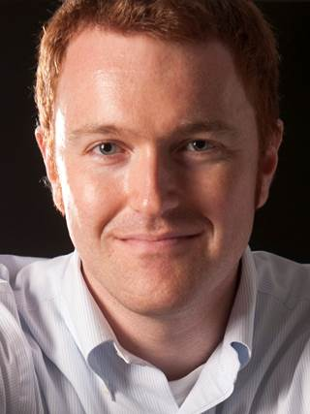
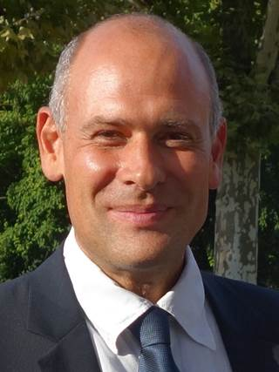
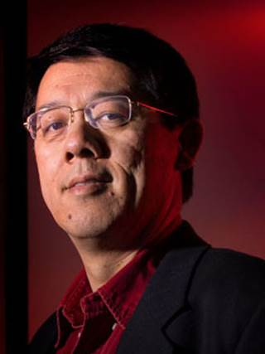
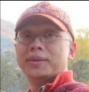
Chunli Bai Editor-in-Chief Chinese Academy of Science, China
 | Xiaodong Chen |  | RongChao Jin |  | Elena Shevchenko
 | Nanyang Technological University, Singapore |  | Carnegie Mellon University, USA |  | Argonne National Laboratory, USA
 | Serena Corr |  | Yamuna Krishnan |  | Lingdong Sun
 | University of Glasgow, UK |  | University of Chicago, USA |  | Peking University, China
 | Yves Dufrêne |  | Quan Li |  | Shouheng Sun
 | Université Catholique de Louvain, Belgium |  | The Chinese University of Hong Kong, Hong Kong |  | Brown University, USA
 | Andrea Ferrari |  | Xiaogang Liu |  | Benjamin Wiley
 | University of Cambridge, UK |  | National University of Singapore, Singapore |  | Duke University, USA
 | Dirk Guldi |  | Paolo Samori |  | Xiao Cheng Zeng
 | Friedrich-Alexander University Erlangen-Nürnberg, Germany |  | University of Strasbourg, France |  | University of Nebraska–Lincoln, USA
 | Xingyu Jiang |  | Sara Skrabalak
 | National Centre for Nanoscience and Technology, China |  | Indiana University, USA
Associate Editors

