Slide 1
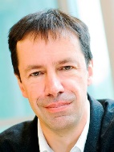
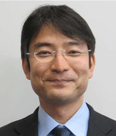
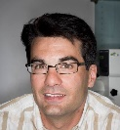
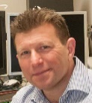
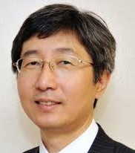
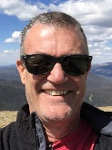
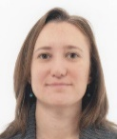
Editor-in-Chief
James Durrant,
Imperial College London
and Swansea University
Associate Editors
Ryu Abe,
Kyoto University
Vincent Artero,
Université Grenoble Alpes, CEA
David Mitlin,
Clarkson University
Nam-Gyu Park,
Sungkyunkwan University
Garry Rumbles,
NREL and
University of Colorado Boulder
Marta Sevilla,
Instituto Nacional del Carbón - CSIC
Publishing high quality scientific research that will drive development of sustainable energy technologies, with a particular emphasis on innovative concepts and approaches.
Free for 2017 & 2018
@SusEnergyRSC
Sister journal of
Energy &
Environmental
Science
Submit now:
rsc.li/sustainable-energy-fuels

